Slide 1
Task 3 on ethical hacking
1
Task Details
Steps
Vedio on steps
Screenshot of Process
Screenshot of output
Final report and so on
2
3
4
Presented by: Sagar Shrey
Email: 20bec1061@cuchd.in
Subject: Ethical Hacking
5
6

Slide 2
Task Details
In http://testasp.vulnweb.com/ we have to Explore the website and try to find vulnerabilities in the website and to report it
1st Page

Slide 3
Steps to Follow
Step 1: Visit http://testasp.vulnweb.com/
Step 2: On the top menu you will find a search option.
Step 3: Click on it and you will be prompted with the Search box.
Step 4: You can intercept the request in Burp Suite
Step 5: Now you can find different payloads for XSS.
Step 6: Send the request to the intruder and paste all the payloads.
Step 7: Try to find a successful payload for XSS.
1st Page

Slide 4
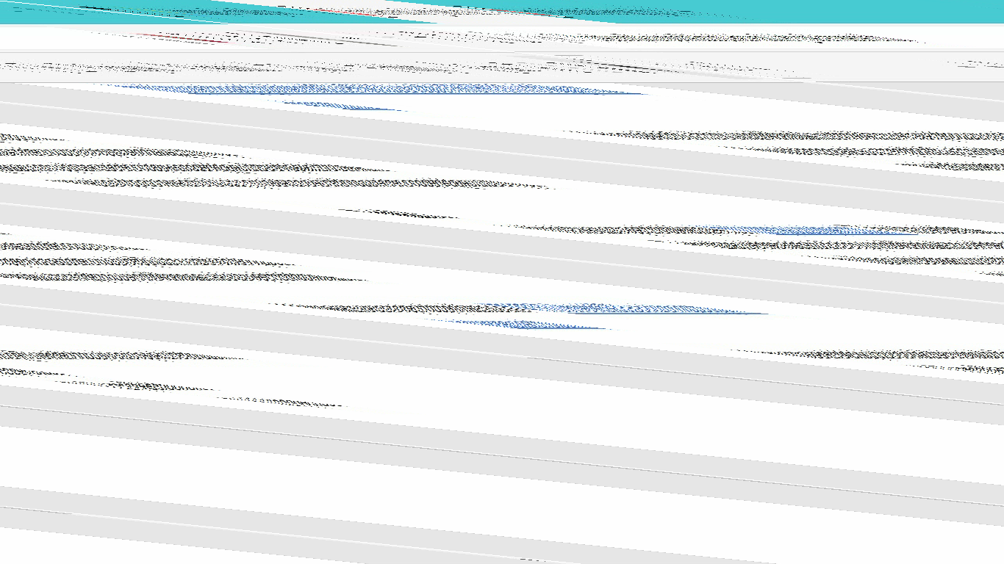
Video on steps of Task
1st Page

Slide 5
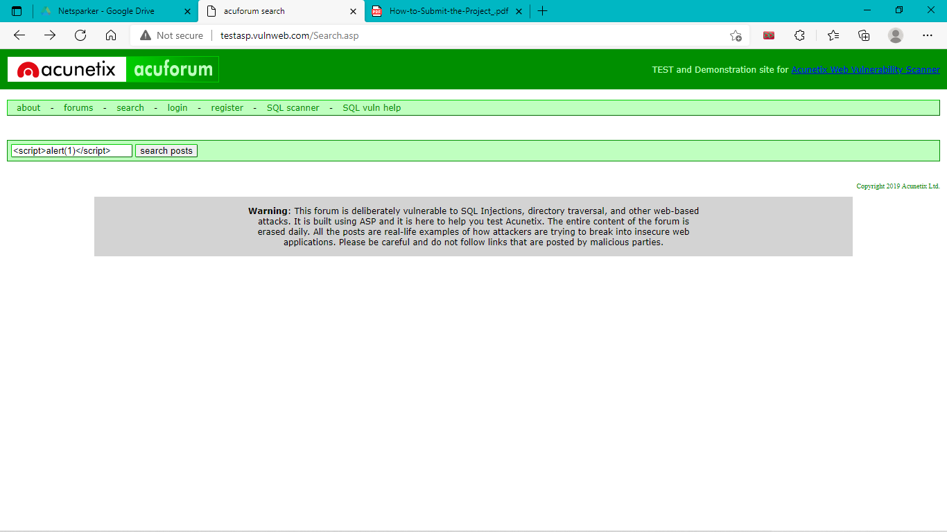
Screenshot of process
1st Page

Slide 6
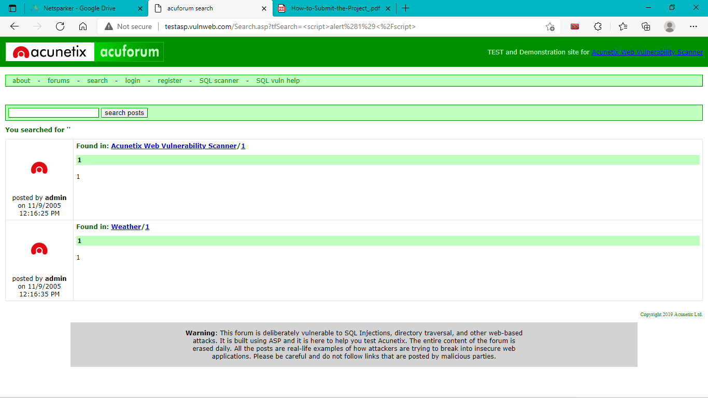
Screenshot of output
1st Page

Slide 7
My report in this task
Domain: http://testasp.vulnweb.com/
Windows 11, following url, wifi
Description: Cross site scripting can lead to stealing our user data and cookies and it can be harmful for our website.
Mitigation: If we want to prevent our website to be vulnerable of cross site scripting then we can just enable nonscript on browser.
Steps, videos and screenshots are already presented in the previous slides.

Slide 8
Acknowledgement
I would like to express my special thanks of gratitude to my teacherwho gave me the golden opportunity to do this wonderful task on the Internship of ethical hacking, which also helped me in doing a lot of research and I came to know about so many new things I am really thankful to him .
1st Page

Slide 9


